Slide 1

EMERGENCY MEDICAL HELP
Minor Project
Presentation

Slide 2
Project Supervisor:-- Dr.Ratnesh lithoiria
Project Co-ordinator:--Dr.Ajay Kumar

Slide 3
INTRODUCTION OF TEAM :--
SUDHANSHU YADAV
Er no.-161B239
UTKARSH RAGHUVANSHI
Er no.-161B256
UTKARSH SINGH
Er no.-161B257
Frontend Developer
Frontend Developer
Frontend Developer
Graphic Designer
Backend Developer
Backend Developer
Project Manager /Planner

Slide 4
PROJECT Introduction:--
This is a medical help website . This site can be very useful for the people who wants medical help online i.e take appointment from the doctor , find a blood donor of matching blood group (or donate blood),get tips on yoga , ayurvedha etc which catagorises in good habits.

Slide 5

Previous & RELATED work
There are lot of medical websites in the world but in India there is no such website for medical aid which provides these many services.
There are lot of foreign medical universities which run online services for medical aid.
There is different websites for blood related issue’s.
Different websites for consulting a doctor.
Different website for buying medicine’s.
e.t.c

Slide 6

OBJECTIVE (Services and help provided through our website)
Donate Blood/Find a donor.
Take other medical helps e.g.-YOGA,AYURVEDA e.t.c.
Take appointment from the doctor.
Buy medicines online through EMH.

Slide 7
Languages & Tools used:--
HTML
CSS
BOOTSTRAP
SQL
PHP
Adobe Photoshop

Slide 8
WEBSITE ARCHITECTURE

Slide 9
USE CASE Diagram:---
System Admin
Blood Donor
Accept Member Registration
Search Blood Donor
Send Blood Registration Alerts
LOGIN
Registration
Update Profile
Donate Blood

Slide 10
Use case diagram for emergency medical help
Patient/Blood Requestor
First-Aid
YOGA
Ayurveda
Share Experience
Get Blood/Donate Blood

Slide 11
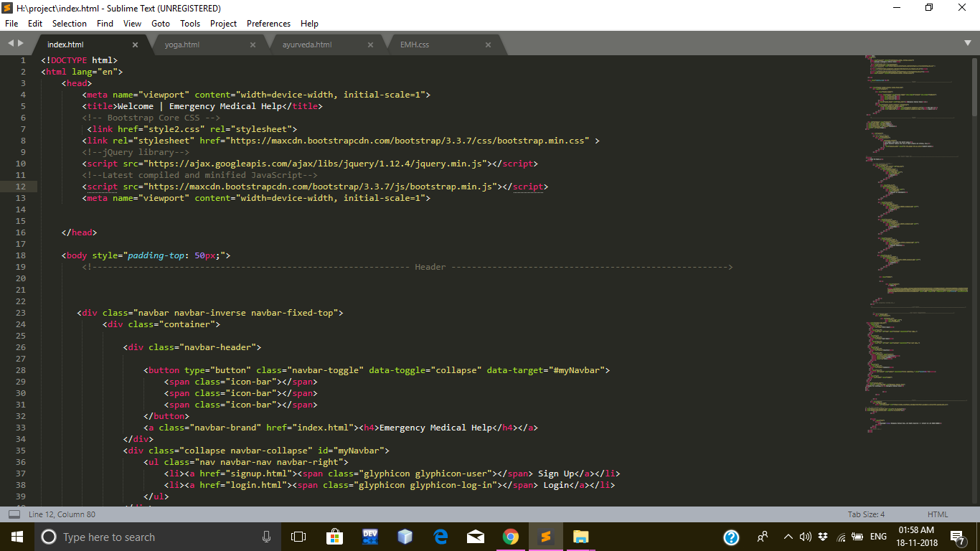
LINE OF CODE(LOC)

Slide 12
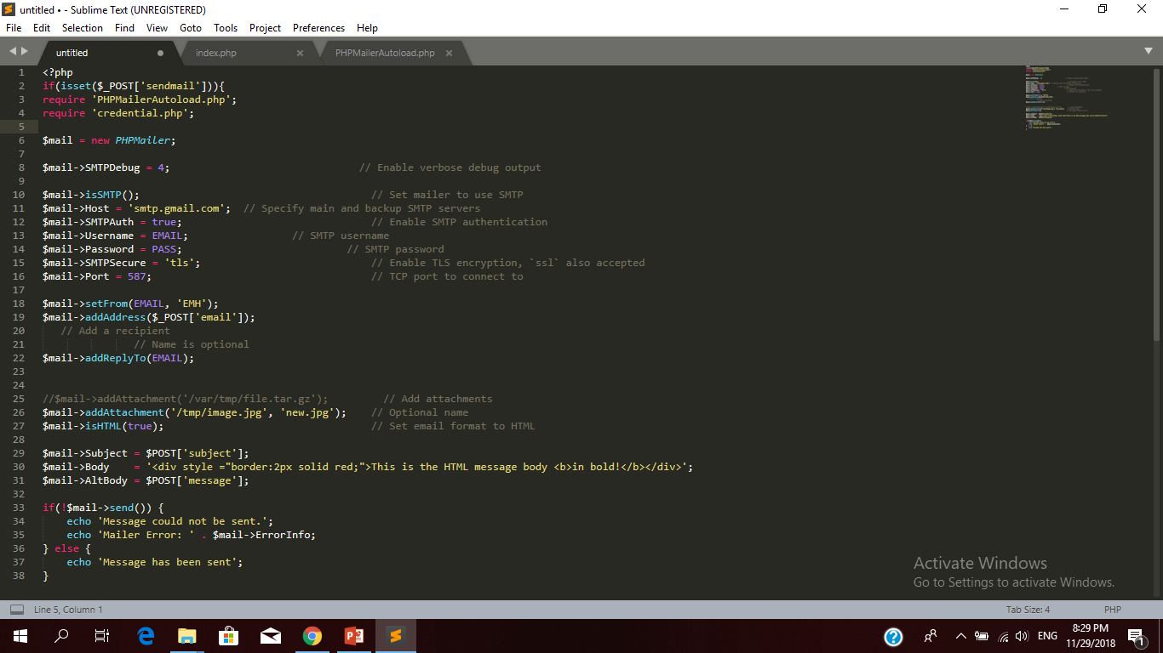
PHP MAILER CODE

Slide 13
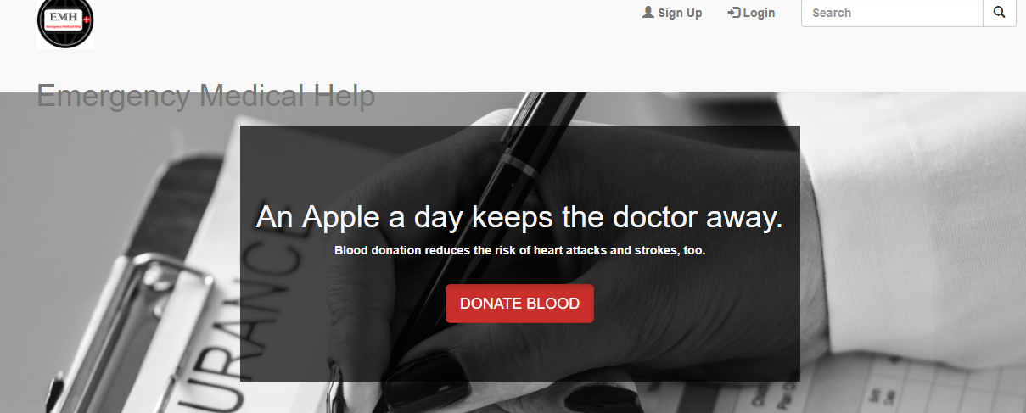
Home page/front page(view of the page)
This is the front page of our website Emergency Medical Help . As you can see it will direct you to various other pages and links of website to get medical help which website prevails.

Slide 14
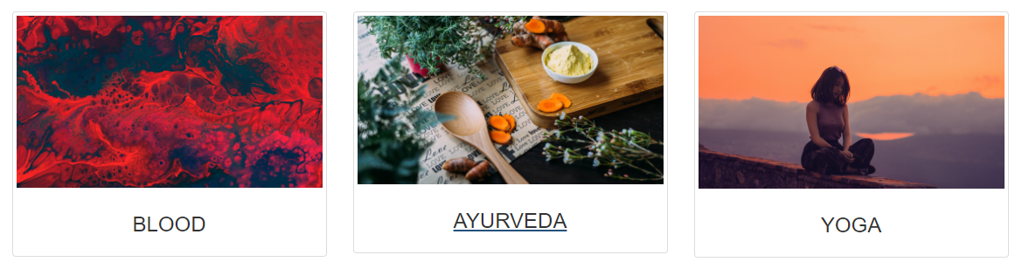
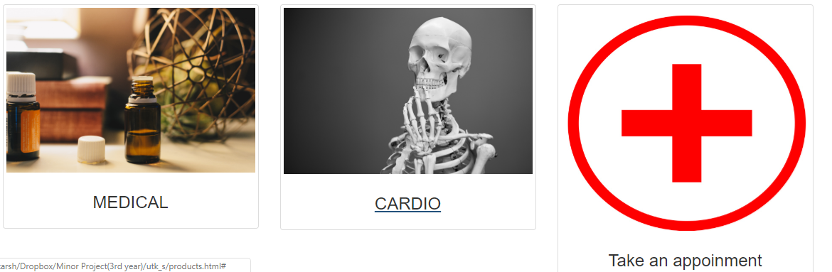

Slide 15
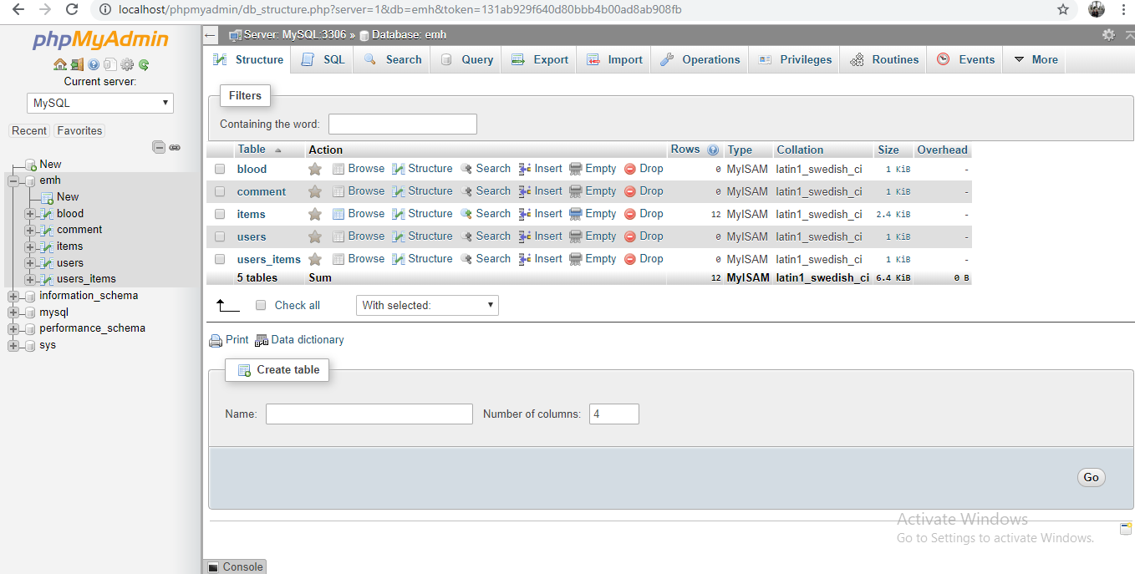
DATABASE connections

Slide 16
Future potential/advantage
In India , there are many websites mend for medical purpose but there is no common platform/website which gives easy and fast access for all the medical facilities at the same place.
This website will provide access to most of the facilities related to health and first-aid purpose.
This website will provide facilities like: Donate Blood/Find a Donor, take appointment etc.
The system provides immediate details of blood available in the donor.
The system is very effective during emergency conditions.
It saves their time and efforts.

Slide 17
Conclusion
This is for public welfare. This project is made keeping in mind that every person in need should get proper support and assistance in form of a emergency medical help. Hence, we have prepared this website for helping the one in need and to provide proper facility and support in certain circumstances.

Slide 18
References
[1] http://en.wepidia.org/wiki/Blood_donation
[2] Web Based Blood Donation System [-by Aware Sachin B , Arshad Rashid , Ansari aadil , Bombale R.R]
[3]”World Blood Donor Day”.World Health Organization. Retrieve 2008-06-01.
[4] https://clevelandclinic.org
[5] The search for online medical help [-by Susannah Fox and Lee Rainie]
[6] N. Bui and M. Zorzi, "Health care applications: a solution based on the internet of things," in Proceedings of the 4th International Symposium on Applied Sciences in Biomedical and Communication Technologies, 2011, p. 131.
[7] K. Govinda and R. Saravanaguru, "Review on IOT Technologies," International Journal of Applied Engineering Research, vol. 11, pp. 2848-2853, 2016.
[8] P. Mahalle, S. Babar, N. R. Prasad, and R. Prasad, "Identity management framework towards internet of things (IoT): Roadmap and key challenges," in International Conference on Network Security and Applications, 2010, pp. 430-439.
[9] Bhatia, Gresha, Algenti Lala, Ashish Chaurasia, and Ramandeep Rajpal,
“Implementation of Cloud computing technology for the improvement of entire healthcare services in India,” In Advances in Technology and
Engineering (ICATE), 2013 International Conference on, pp. 1–5, IEEE,
2013.

Slide 19
End of presentation
THANKYOU

